Slide 1
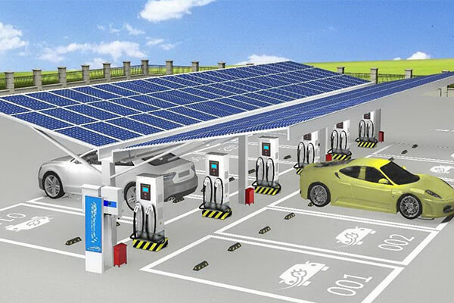

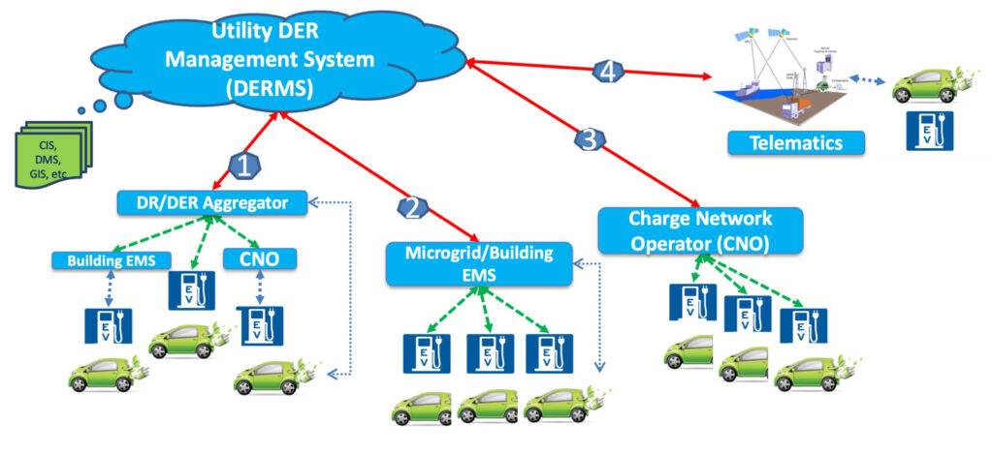


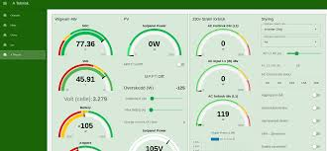
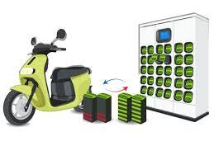
Title –
Design of IOT Architecture for Battery Charging Management System
Presentation on Major project
2nd Sem – Review -2
Presented by
Jagadeesh_(AP2312210002)
under the Esteemed guidance of
Dr. Sujith Kalluri Ph.D
Associate Professor
School of Engineering and Sciences (SEAS)
Department of Electronics and Communication Engineering
SRM University, Andhra Pradesh (SRM AP)

Slide 2

Outline
2_2 Revied Work
Problem Formulation (Current Trends & Technology)Research gap
Bridging the Gap in Sustainable EV Charging
Methodology & Design
Proposed Methodology
System Design & Validation
Implementation
Project overview

Slide 3
Problem Formulation (Current Trends & Technology)
- Challenges in Modern EV Charging Infrastructure
Current Trends
Surging global EV adoption (CAGR of 21.7% from 2023–2030).
Shift toward renewable energy (solar/ESS) and smart grid integration.
Demand for fast charging (80% charge in 30 mins) and battery swapping to reduce downtime.
Technological Limitations
Grid Instability
Renewable Integration Gaps
Inefficient Load Management
High Costs
3. Industry Pain Points
Range anxiety due to slow charging speeds.
Fragmented infrastructure with limited scalability.
Poor battery health monitoring leading to premature degradation.

Slide 4
Bridging the Gap in Sustainable EV Charging
Dynamic Energy Prioritization:
No hierarchy for solar → ESS → grid, leading to inefficiency.
Real-Time Adaptability:
Inability to adjust to solar intermittency or load spikes (e.g., peak hours).
Cost-Effective Scalability:
High OPEX due to grid dependency and manual monitoring.
Battery Health Optimization:
Impact:
Grid instability, higher carbon footprint, and slower EV adoption.
Limited SOC/temperature monitoring increases failure risks.

Slide 5
Methodology & Design
- IoT-Driven EV Charging Architecture: Methodology & Design
1. Five-Layer IoT Architecture:
Sensor Layer: Collects real-time data (voltage, current, SOC, temperature).
Microcontroller Layer: Processes data for fault detection and load balancing.
Communication Layer: MQTT/HTTP protocols for low-latency device-to-cloud connectivity.
Cloud Layer (AWS): Stores data, runs predictive analytics.
User Interface (Node-RED): Real-time dashboards for monitoring and control.
2. Core Algorithms:
SOC Calculation: Prevents overcharge/deep discharge via voltage thresholds (20–100% SOC).
MPPT: Maximizes solar harvest under shading/temperature changes.
Predictive Analytics: Forecasts energy demand using ML models.

Slide 6
System Design & Validation
1. Power Integration at PCC:
Schematic: Solar panels → Bidirectional converter → ESS → Grid.
Automation: Seamless transitions between sources based on real-time conditions.
2. Simulation Validation:
MATLAB Results: Solar (1,032 kW/day), ESS (576 kW/day), Grid (209 kW/day).
Node-RED Dashboard: Real-time monitoring of SOC, energy flow, and alerts.
3. Tools & Standards:
Software: MATLAB/Simulink, AWS IoT Core, Node-RED.
Standards: IEEE 1547 (grid integration), IEC 62196 (EV charging).

Slide 7

Implementation
MATLAB
NODE RED
AWS Cloud
Thingspeak
Dashboard

Slide 8

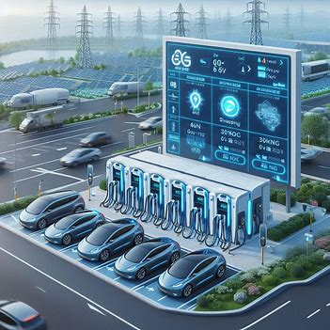
Project overview
Problem Statement
Increasing of EV Charging Infra
Power Grid Instability
Real Time Monitoring
Load Management
Data Monitoring
High operational cost
Literature survey
4 – EV Charging Startup companies
EV Charging Stations
Energy Storage Systems
Battery Swapping Stations
IOT Integration
Sensing and Monitoring
Machine Learning Approach
Research gap / Market Requirements
IoT Connectivity
Real Time Monitoring
Power Load Management
Grid Stability
Integration & Automation
Cloud Data Storage
Proposed Methodology
IOT Architecture for Battery charging management
PCC integration and Automation
Algorithms
Designed Proposed Simulation Model in MATAB Simulation
Integrated PCC –Fully Automated & Logically connected
Swapping Station and DC Fast Charging
Central Monitoring Station
Estimated Calculated Spread sheet of Cost and Energy
Core work
Integration of 3 Power Sources
Automation on sources availability
30 no’s of EV Swapping Station
4 units of DC Charging station
Remote monitoring with Node-red
AWS Cloud Integration
Indian Patent Published –
202541009491
Anveshan – Zonal Level
Outcomes
Energy Saving – 88.6%
Cost Saving – 88.5%
Research Paper
H/W_ Prototype Implementation

Slide 9
Reference
Cheng-Ta Chiang; Liang-Yu Chien “A Pitaya Dye-Sensitized Solar Cell Monitor for Environmental Sunlight Intensity Detection” IEEE Sensors Journal, 19-11, 03 February 2019.
Saswat Kumar Ram; Sauvagya Ranjan Sahoo; Banee Bandana Das; Kamalakanta Mahapatra; Saraju P. Mohanty “Eternal-Thing: A Secure Aging-Aware Solar-Energy Harvester Thing for Sustainable IoT” IEEE Transactions on Sustainable Computing, 6-2, 15 April 2020.
Tai-Yeon Ku; Wan-Ki Park; Hoon Choi “ESS Simulation based on PV Generation Prediction” 2018 International Conference on Information and Communication Technology Convergence (ICTC), 18 November 2018.
Abdelrahman Ahmed; Sobhy Abdelkader; Ehab Ayman “IoT-based optimization of microgrid operation” 2023 24th International Middle East Power System Conference (MEPCON), 18 March 2024.
George Y. Odongo; Richard Musabe; Damien Hanyurwimfura; Abubakar Diwani Bakari “An Efficient LoRa-Enabled Smart Fault Detection and Monitoring Platform for the Power Distribution System Using Self-Powered IoT Devices” IEEE Access (Volume: 10), 07 July 2022.
Isa Hafidz; Ardyono Priyadi; Margo Pujiantara; Dimas Okky Anggriawan; Mauridhi Hery Purnomo “Development of IoT-Based Portable Power Quality Monitoring on Microgrids by Enhancing Protection Features” IEEE Access (Volume: 11), 15 May 2023.
Dan Zheng; Fushuan Wen; Jiansheng Huang “Optimal planning of battery swap stations” International Conference on Sustainable Power Generation and Supply (SUPERGEN 2012), 04 April 2013.
Bansilal Bairwa; Mrinal Sarvagya; Sanjeeva Kumar; Arpita Banik “Battery Swapping Mobile Service Station for Electric Vehicles Application” 2021 Second International Conference on Smart Technologies in Computing, Electrical and Electronics (ICSTCEE), 15 February 2022.
Xian Zhang; Guibin Wang “Optimal dispatch of electric vehicle batteries between battery swapping stations and charging stations” 2016 IEEE Power and Energy Society General Meeting (PESGM), 14 November 2016.
Sayantika Sikdar; Madhavi Damle “IoT Solutions for Electric Vehicles (EV) Charging Stations: A Driving Force Towards EV Mass Adoption” 2022 International Interdisciplinary Humanitarian Conference for Sustainability (IIHC), 17 March 2023.
Ashutosh Vijay Panchbhai; Ramakrishnan Raman; Chintan Bhupeshbhai Thacker; S. Muthumarilakshmi; S. Murugan “Residential Electric Vehicle Charging Station Using the Internet of Things” 2023 International Conference on Power Energy, Environment & Intelligent Control (PEEIC), 13 March 2024.
S. Arulmozhi; M. Abiramavalli; M.B.Diviya Bhavaani; S. Loganayagi “IoT enabled E-Vehicle Charging System with Battery Monitoring and Charge Scheduling” 2023 First International Conference on Cyber Physical Systems, Power Electronics and Electric Vehicles (ICPEEV), 19 January 2024.
Joe-Air Jiang; Jen-Cheng Wang; Hung-Shuo Wu; Chien-Hsing Lee; Cheng-Ying Chou; Li-Cheng Wu “A Novel Sensor Placement Strategy for an IoT-Based Power Grid Monitoring System” IEEE Internet of Things Journal, 7-8, 30 April 2020.
Enrique A. Sanabria-Torres; Adriana C. Luna; Nelson L. Diaz; Fabio Andrade-Rengifo “State-of-Charge Equalizations Comparison in a Multi-prosumer Environment Based on Real-Time Energy Management Systems with IoT-Support” 2023 IEEE Applied Power Electronics Conference and Exposition (APEC), 31 May 2023.
Santosh Kumar Tripathi; Swati Maurya; Aditi Dubey; Prakhar Pal; Aparna Tiwari “IoT Based Electrical Vehicle Battery Management System with Charge Monitor and Fire Protection” 2024 3rd International conference on Power Electronics and IoT Applications in Renewable Energy and its Control (PARC), 04 April 2024.
Mersin, Türkiye “An IoT -based Power Management System for EV Chargers” 6th Advanced Engineering Days (AED), 5 March 2023.

Slide 10
Thankyou
*
"Engineering problems are under-defined; there are many solutions, good, bad, and indifferent. The art is to arrive at a good solution."
- Richard James

